Slide 1
Agenda
Introduction to AI/ML
What are Large Language Models (LLMs)?
Overview of ChatGPT and GPT models
Azure Open AI Service
Azure Search
Q&A

Slide 2
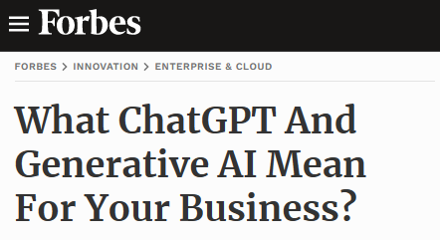
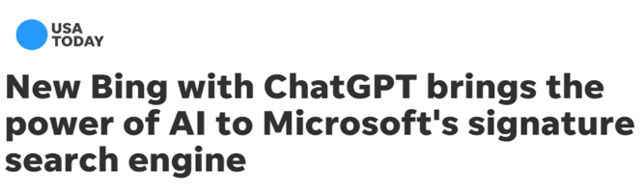
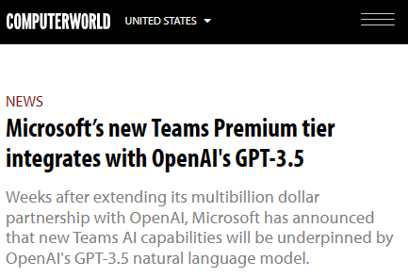
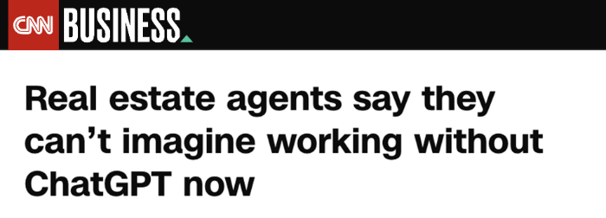

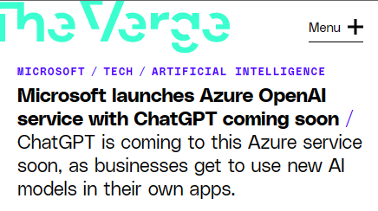
The AI technology is here

Slide 3
AI and ML
AI = Vision
ML = Actual / “Product”

Slide 4
History of AI
Artificial Intelligence
Artificial Intelligence
The field of computer science that seeks to create intelligent machines that can replicate or exceed human intelligence
1956
Machine Learning
Machine Learning
Subset of AI that enables machines to learn from existing data and improve upon that data to make decisions or predictions
1997
Deep Learning
Deep Learning
A machine learning technique in which layers of neural networks are used to process data and make decisions
2017
Generative AI
Generative AI
Create new written, visual, and auditory content given prompts or existing data
2021

Slide 5
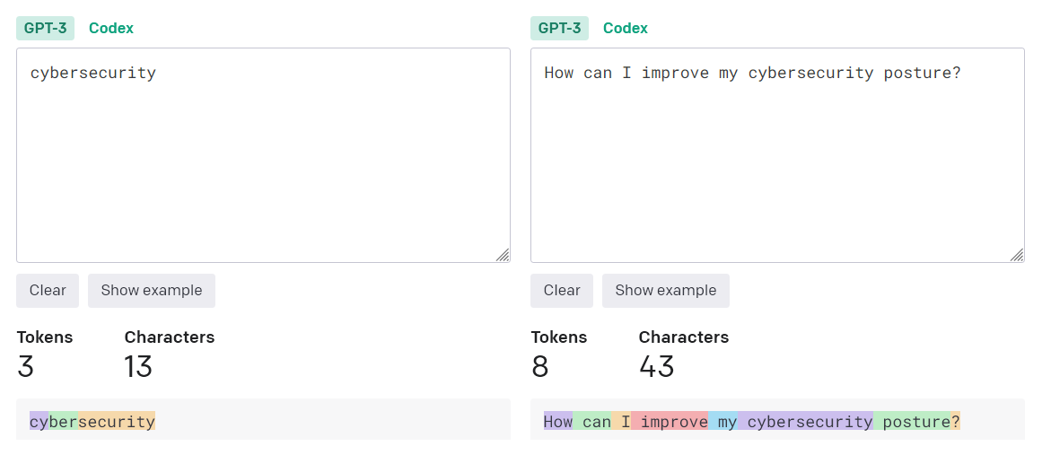
Vocabulary
Token (e.g., a character or word)
One token generally corresponds to ~4 characters of text (English)

Slide 6
Vocabulary
Model (e.g., patterns or relationships in your data)
Large Language Models (i.e., “language calculators”)
Large: More data than can be manually labeled
Language: Match context and words (e.g., word prediction, creative writing)
Model: Semi-supervised learning

Slide 7
Vocabulary
Generative Pre-trained Transformer (GPT)
Generative: Generates new content
Pre-Trained: Trained on data before fine-tuning
Transformer: Understands relationships b/w words
"Few-shot" learning
Reinforcement Learning from Human Feedback (RLHF)

Slide 8
ChatGPT
Chat-GPT: AI Chatbot, developed by OpenAI, trained to perform conversational tasks and creative tasks
Backed by GPT-3.5 model (gpt-35-turbo), GPT-4 models
Trained over 175 billion machine learning parameters
Conversation-in and message-out
Note: Chat Completion API for GPT-4 models
GPT-4 is multimodal (e.g., images + text)

Slide 9
Comparison of GPT model versions
GPT-3.5
GPT-4
Should be first choice for most use cases
Optimize inference time and performance
Suitable for a large range of use cases
Most economical GPT model in Azure OpenAI Service
Increased context awareness
Improved problem solving and reasoning capabilities
Increased token limit - works well for longer content
Iterative refinement:
Paste in code errors & GPT-4 will fix for you
Iterate on stories

Slide 10
Azure OpenAI Service
Large pretrained foundation AI models custom-tunable with your parameters and your data
GPT-3.5
GPT-4
Codex
DALL·E 2 (preview)
GPT-3.5
GPT-4 (preview)
Codex
DALL·E 2 (preview)
Generative Text Models, with varying capabilities and uses
Specialized Generative Coding Model
Generative Image Model

Slide 11
Comparison of GPT model versions
GPT-3.5
GPT-4
Should be first choice for most use cases
Optimize inference time and performance
Suitable for a large range of use cases
Most economical GPT model in Azure OpenAI Service
Increased context awareness
Improved problem solving and reasoning capabilities
Increased token limit - works well for longer content
Iterative refinement:
Paste in code errors & GPT-4 will fix for you
Iterate on stories

Slide 12
Azure Search
A fully managed search-as-a-service in Microsoft Azure, allowing developers to build powerful search experiences.
Key Features:
Indexing and Querying: Quickly ingest and search through large volumes of structured and unstructured data.
Scalability: Elastic scaling ensures performance and capacity meet demand.
Integration: Seamlessly integrate with other Azure services and external data sources.
AI Integration: Utilize AI capabilities for enhanced search experiences.

Slide 13
Benefits of Azure Search
Improved User Experience: Deliver relevant and personalized search results.
Time and Cost Savings: Reduce development time and operational costs with managed services.
Scalability and Performance: Scale resources dynamically to handle fluctuating workloads.
Insights and Analytics: Gain valuable insights into user behavior and search patterns.

Slide 14
Integration of Azure Search and OpenAI
Synergies: Combining Azure Search's indexing and querying capabilities with OpenAI's natural language processing enables intelligent information retrieval.
Use Cases:
Semantic Search: Enhance search queries with natural language understanding to provide more relevant results.
Content Summarization: Generate concise summaries of documents or articles for improved search result previews.
Question Answering: Implement chatbots or virtual assistants that can answer user questions by leveraging AI-powered language models.

Slide 15
Benefits of Integration
Enhanced Relevance: Improve search relevance by understanding user intent and context.
Increased Efficiency: Automate tasks such as content summarization and question answering, saving time and effort.
Better User Engagement: Deliver personalized and interactive search experiences that keep users engaged.

Slide 16
Choosing a use case
Use cases to avoid
Not suitable for open-ended, unconstrained content generation.
Sending automated AI advice or generatively developed content directly to a decision-maker without human review.
Avoid scenarios where use or misuse of the system could result in significant physical or psychological injury to an individual.
Carefully consider use cases in high stakes domains or industry.
Use cases to evaluate
Start small and build from there. Azure OpenAI is an Azure Service that has both generative and non-generative capabilities.
Use cases involving text analysis, summarization, forms or content generation are the sweet spot.
Information discovery and knowledge mining.

Slide 17
Cost Estimation
Pricing varies per region and usage, so it isn't possible to predict exact costs for your usage.
Azure App Service: Basic Tier with 1 CPU core, 1.75 GB RAM. Pricing per hour. Pricing
Azure OpenAI: Standard tier, GPT and Ada models. Pricing per 1K tokens used, and at least 1K tokens are used per question. Pricing
Azure AI Document Intelligence: SO (Standard) tier using pre-built layout. Pricing per document page, sample documents have 261 pages total. Pricing
Azure AI Search: Standard tier, 1 replica, free level of semantic search. Pricing per hour.
Azure Blob Storage: Standard tier with ZRS (Zone-redundant storage). Pricing per storage and read operations. Pricing
Azure Monitor: Pay-as-you-go tier. Costs based on data ingested. Pricing

Slide 18
Customer Stories
Serving customers 78% faster: VOCALLS’ voicebots supercharge call handing with Azure OpenAI https://customers.microsoft.com/en-us/story/1725778377710136622-vocalls-azure-telecommunications-en-czechia
Connecting with 500 million passionate fans worldwide https://customers.microsoft.com/en-us/story/real-madrid
Our in-house Azure-based search engine is equipped with AI and semantic capabilities to index terabytes of data across various heterogeneous data sources—thereby democratizing Beiersdorf’s R&D knowledge among our research scientists. https://customers.microsoft.com/en-us/story/1552642769228088273-Beiersdorf-consumer-goods-azure-cognitive-search

Slide 19

Thank you
Microsoft AI

Slide 20
Q&A

